Slide 1
Final Project React Name: Varsha Hunjan

Slide 2
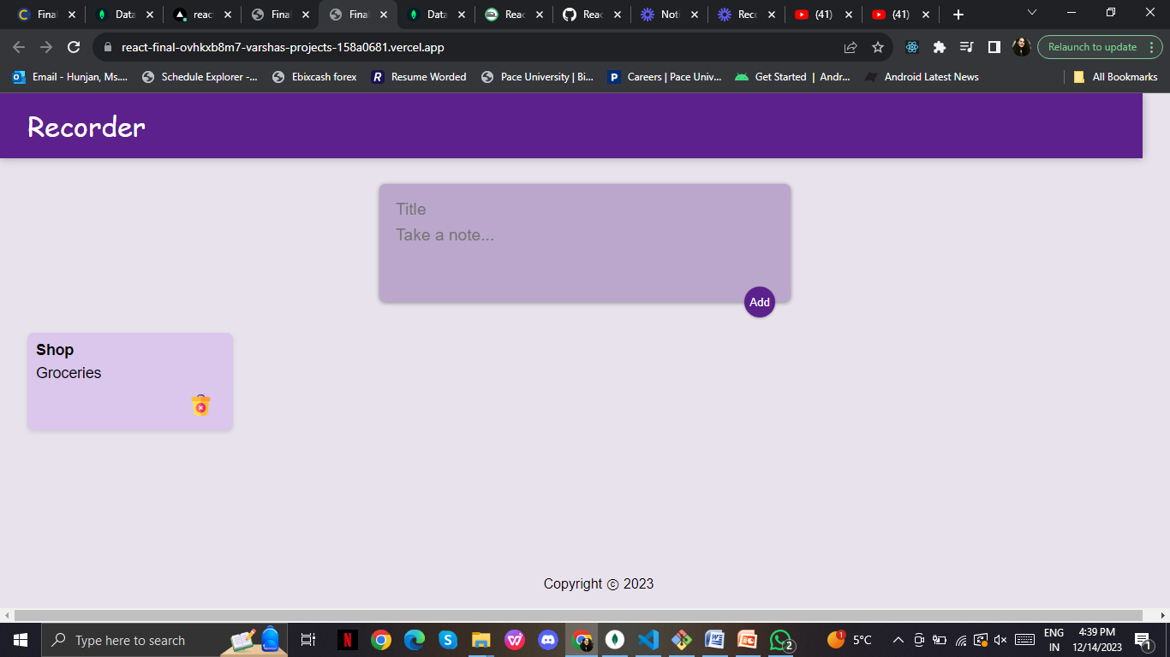
Vercel Link
https://react-final-app-six.vercel.app/

Slide 3
Railway
Link:
https://railway.app/project/a477e23f-3864-4239-b2b4-18cb50e15fb1/service/25abfcd9-add4-437c-bddb-97e00f2345ab?id=ac22bbd8-90c7-41d0-8ca7-e206245730b7
Code: { "$schema": "https://railway.app/railway.schema.json", "build": { "builder": "NIXPACKS" }, "deploy": { "numReplicas": 1, "sleepApplication": false, "restartPolicyType": "ON_FAILURE", "restartPolicyMaxRetries": 10 } }

Slide 4
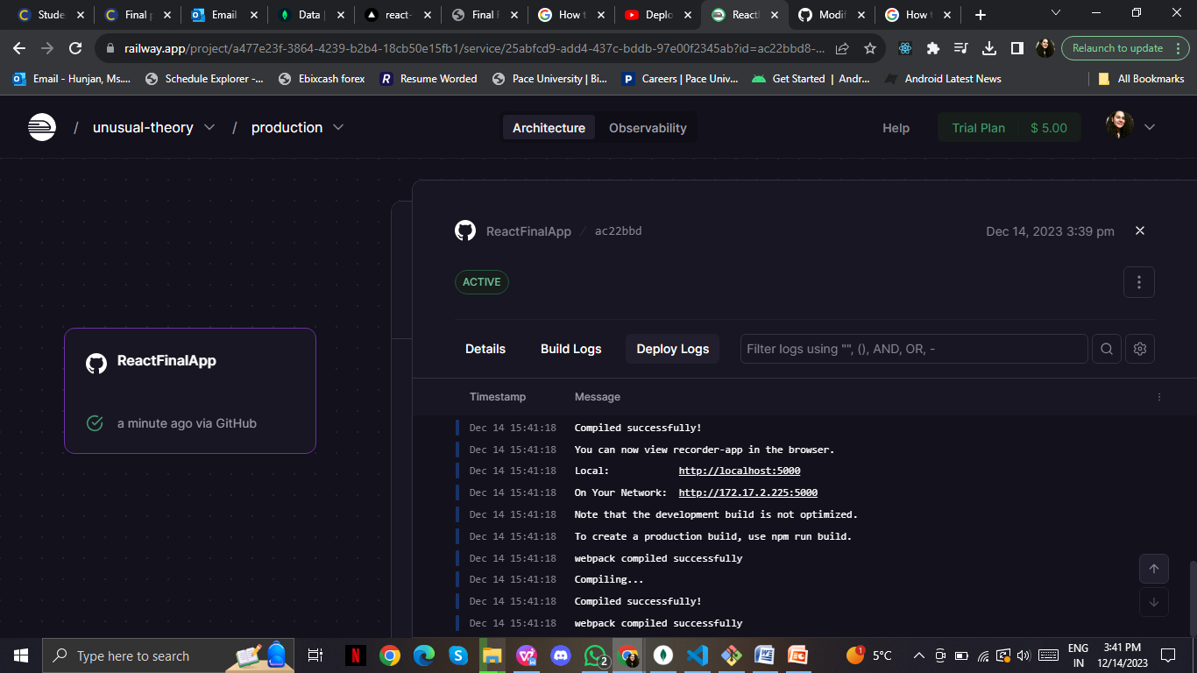

Slide 5
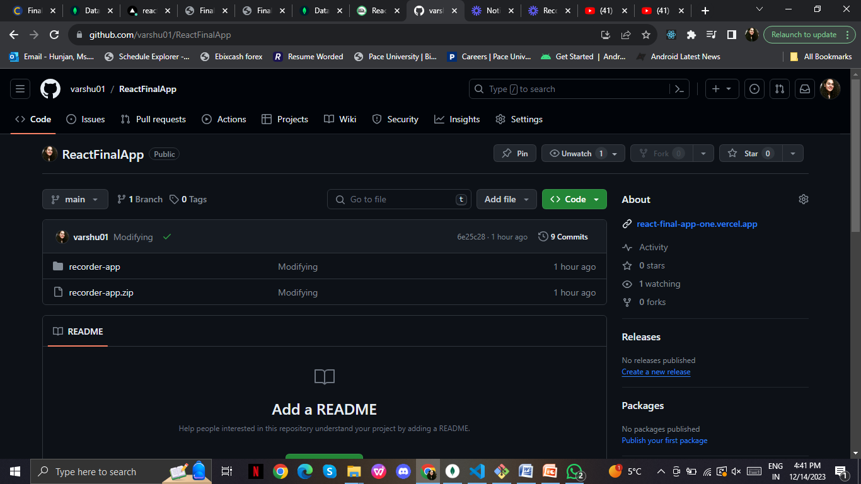
Github repo link
https://github.com/varshu01/ReactFinalApp.git

Slide 6
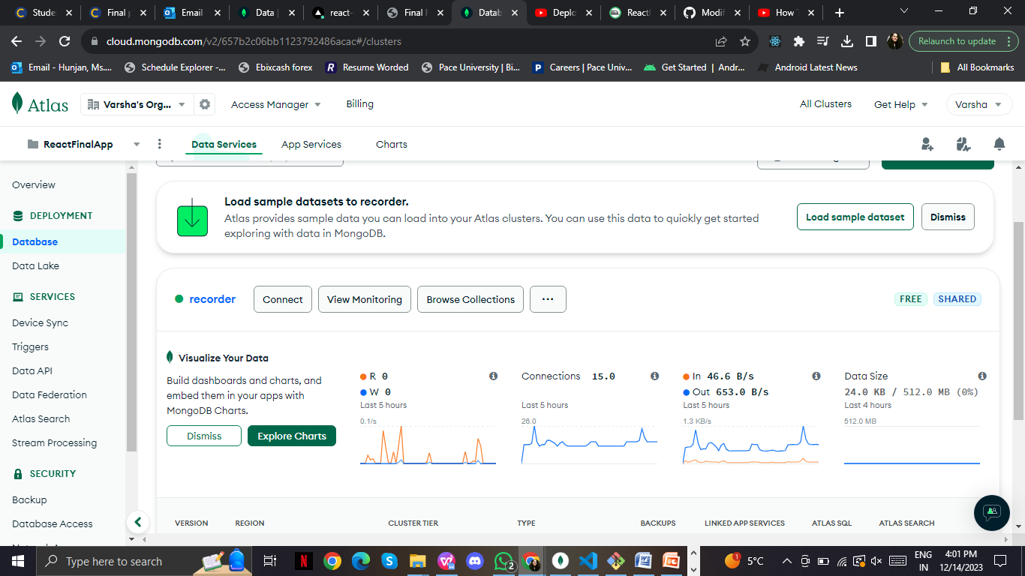
MongoDB Atlas

Slide 7
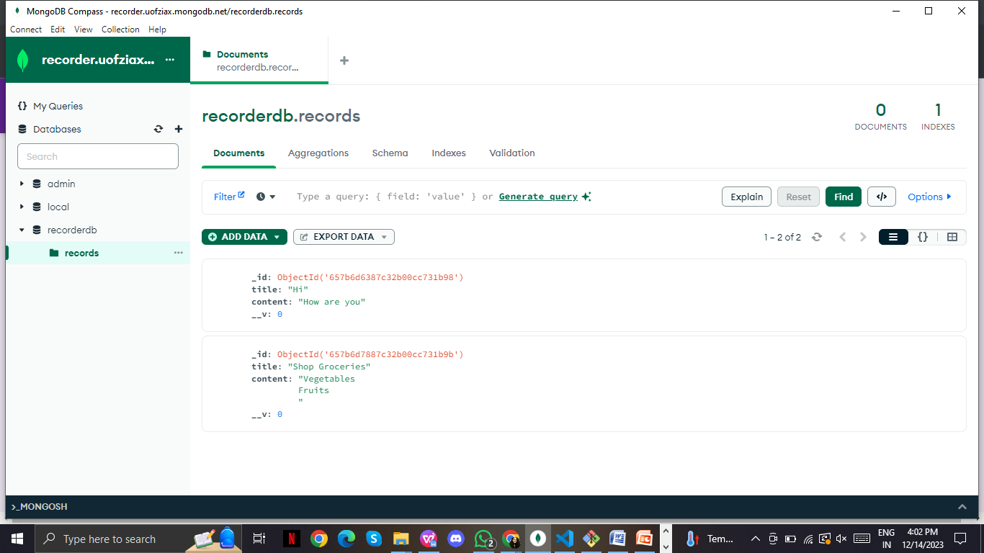
MongoDB Compass

Slide 8
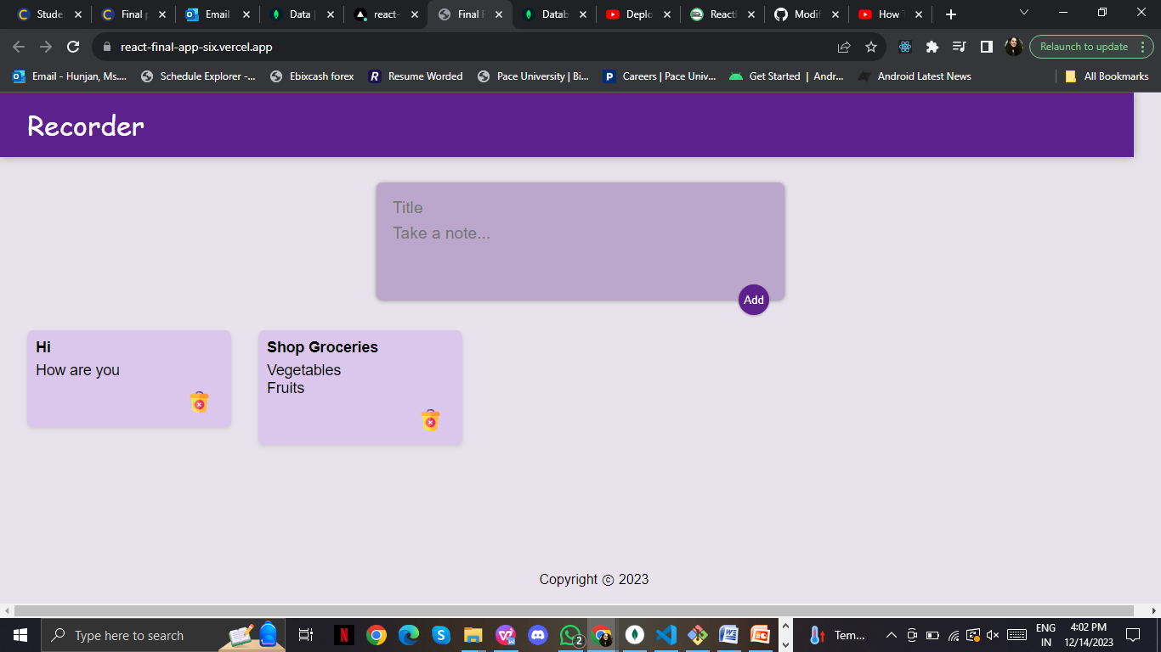

Slide 9
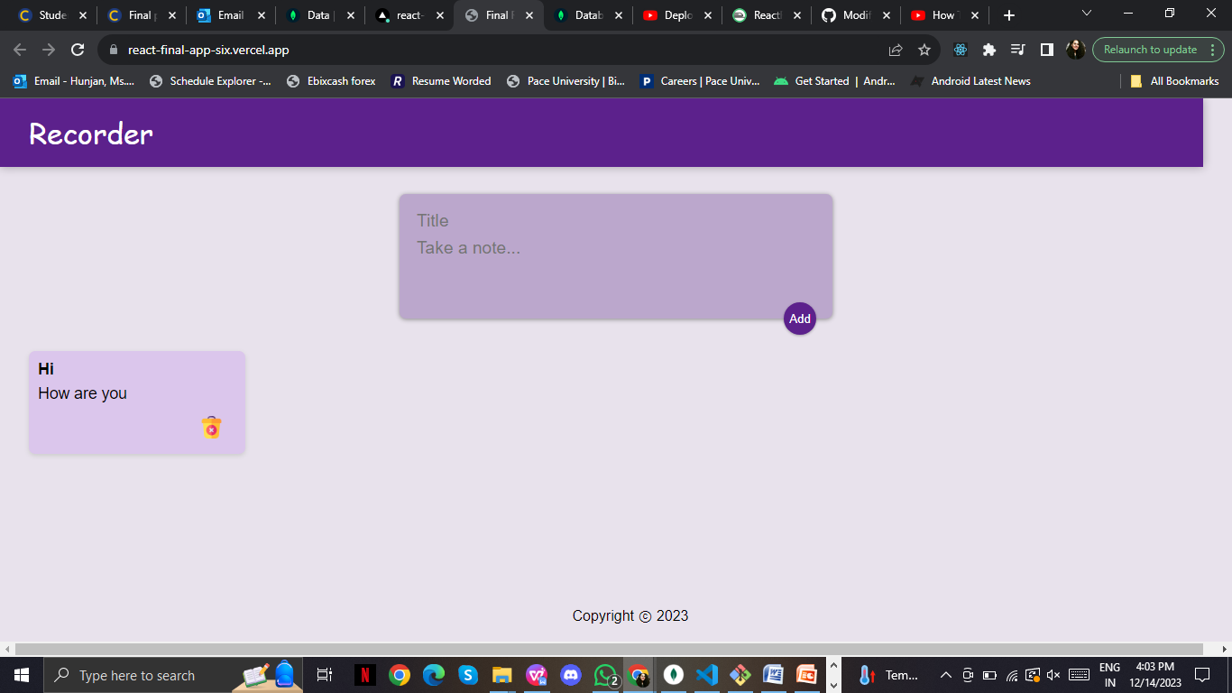
After deleting

Slide 10
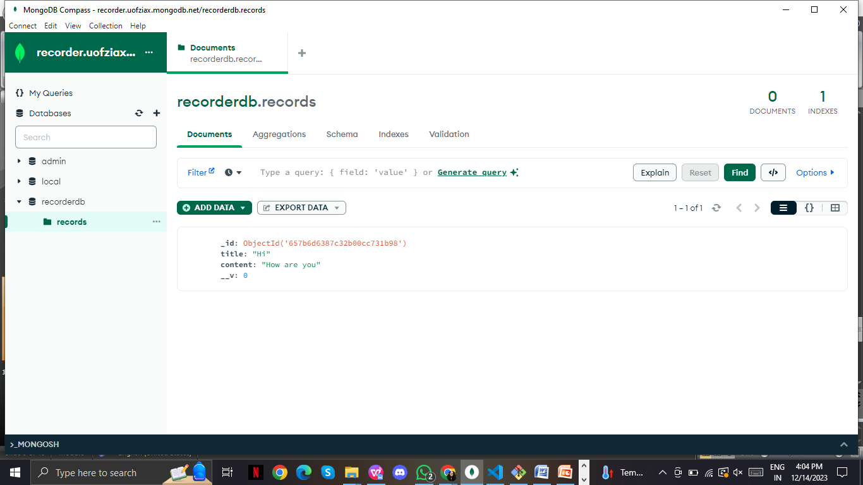
MongoDB Compass

Slide 11
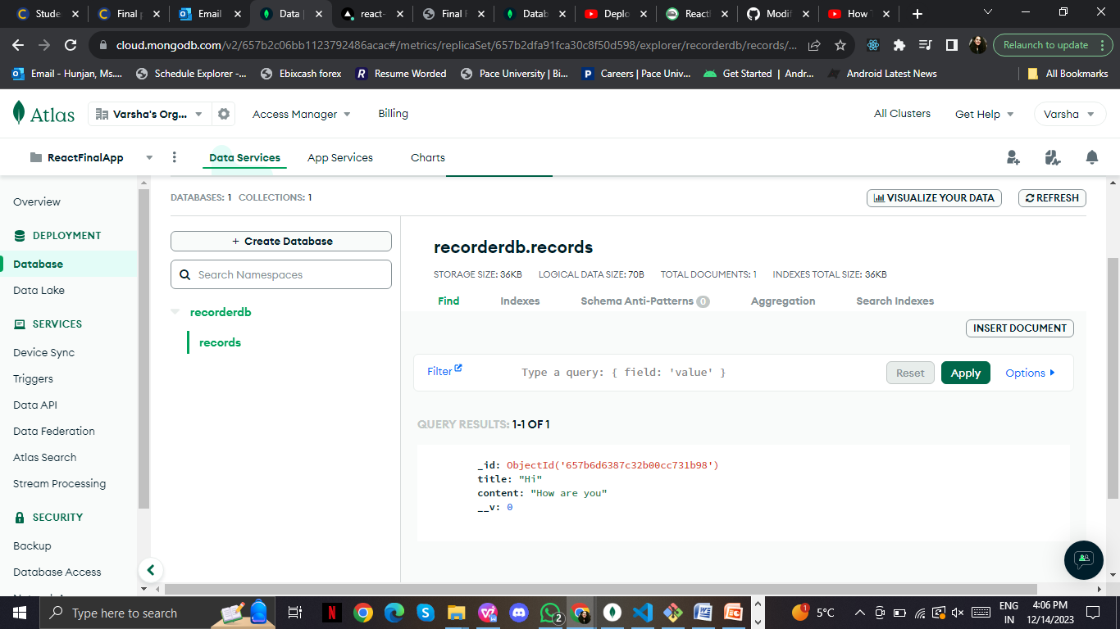
In MongoDBAtlas

Slide 12
Video
Link: https://www.youtube.com/watch?v=7YfD3JYiqs8
00:00 Introduction
00:24 Backend Setup
00:56 Database Creation
01:21 Code Availability
01:48 Frontend Overview
02:16 Adding a New Note
02:41 Database Verification
03:01 Note Deletion

Slide 13

Please press anywhere on screen to play

Slide 14
Reference videos:
https://www.youtube.com/watch?v=N9hrClMJFqk
https://youtu.be/tkAmFt64DCk?feature=shared
https://www.youtube.com/watch?v=2HBIzEx6IZA

Slide 15
Things learnt
How to make React project
How to connect a React app to backend
How to use MongoDB Atlas and Compass
How to deploy apps on Vercel and Railway
How does backend database work

Slide 16
Thank You!

